Slide 1
Contents
2
Introduction
Objective
Equipments required
Block diagram of the sensor system
Block diagram of the device in train
Working Concept
Challenges
Future Scope
Conclusion
References

Slide 2
Introduction
3
The measurement of the velocity is crucial in wide range of scenarios, from security system to transportation safety.
IoT refers to the network of connected devices and the technology that allows them to communicate with each other.
Data transmission involves the collection and transmission of data from sensor system to destination device through IoT.

Slide 3
OBJECTIVES
4
Development of a contactless velocity detection system.
Designing of a IoT-based communication system for better data transmission in the railway system.
Experimentation of IoT-based velocity detection system.

Slide 4

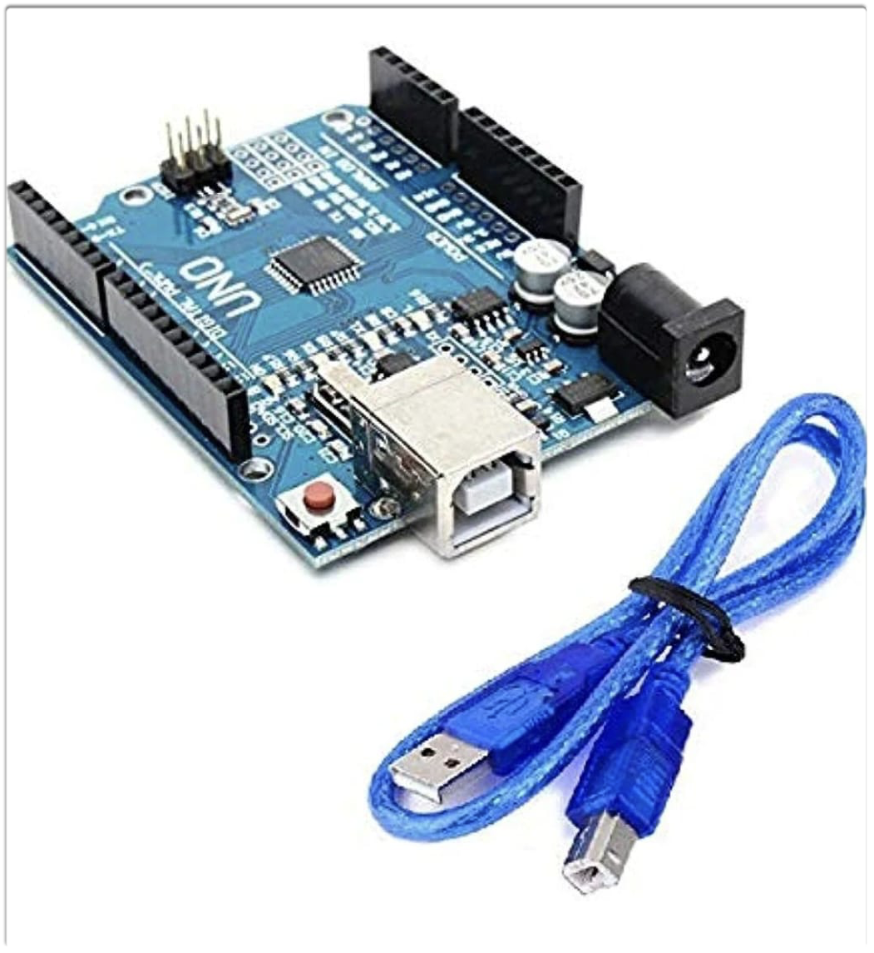
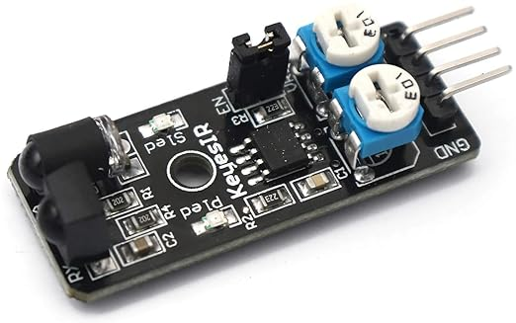
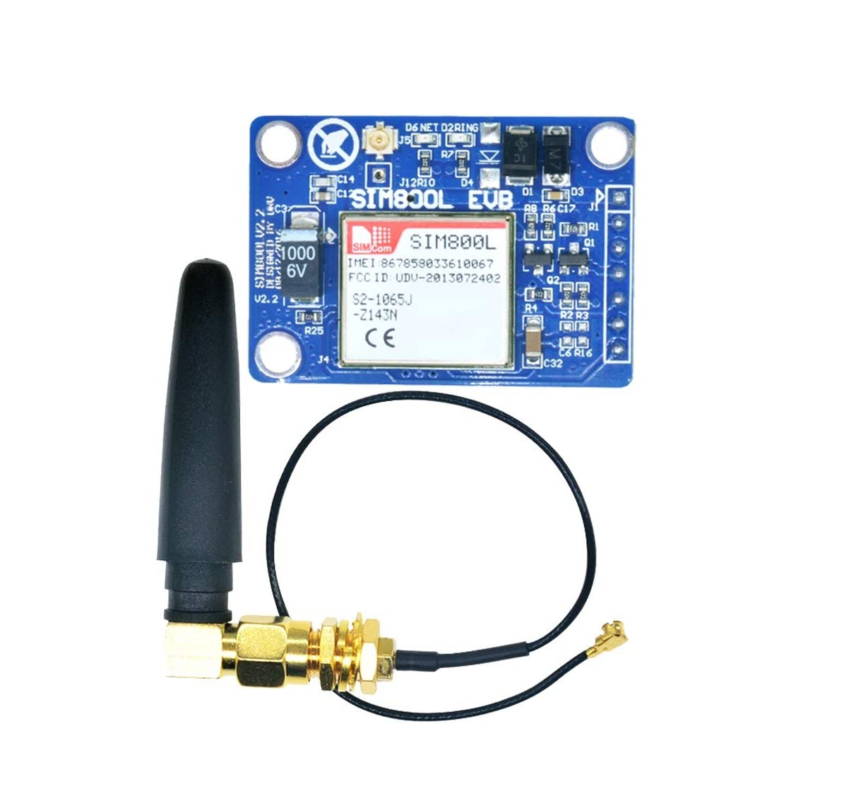
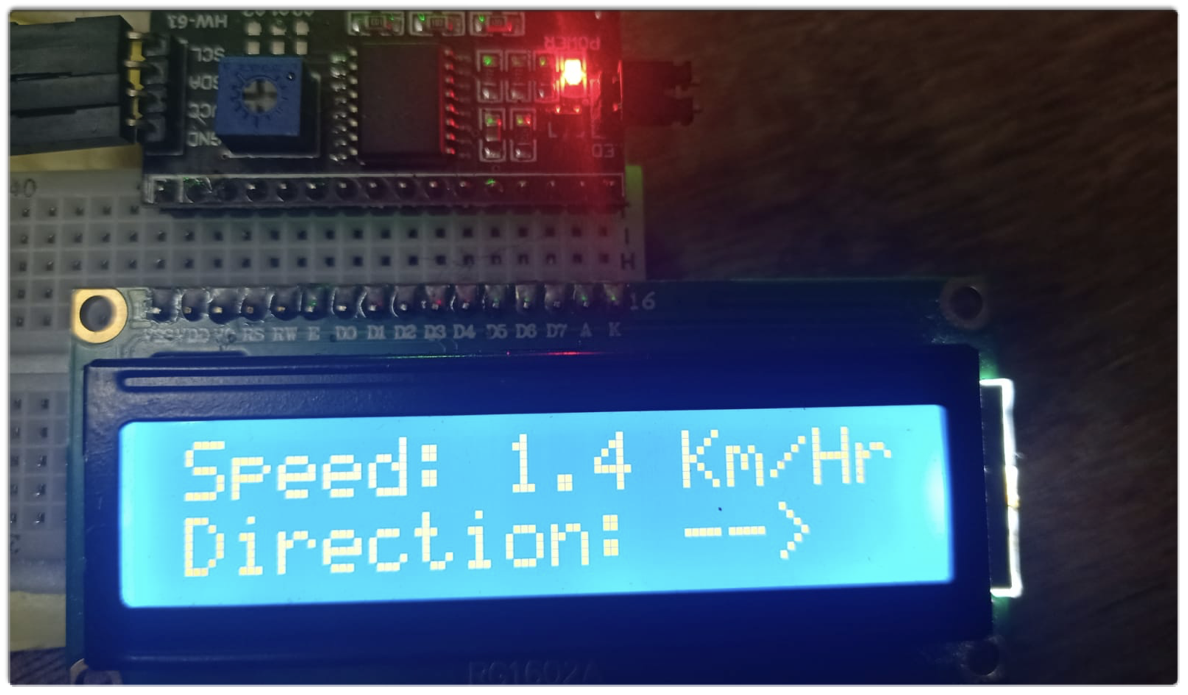
Equipments required
5
KY-032 IR Sensor
Arduino
LCD
GSM module

Slide 5
Arduino
6
Arduino is an open-source hardware electronic platforms that simplifies programming microcontrollers for creating interactive electronic projects.
Arduino

Slide 6
Ky-032 IR Sensor
7
IR sensor detect the infrared radiation in its vicinity and converts it into an electrical signal commonly used for applications like motion detection of an objects.
KY-032 IR Sensor

Slide 7
8
SIM 800L WIRELESS GSM MODULE
A GSM(Global System for Mobile Communications) module refers to a specialized hardware device that utilizes GSM technology to enable communication capabilities through cellular networks.
GSM module

Slide 8
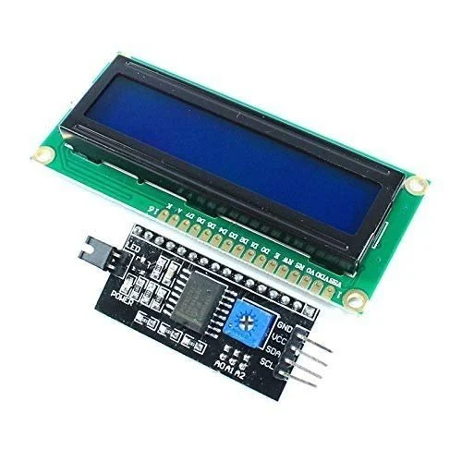
9
LCD WITH I2C MODULE
An LCD (Liquid Crystal Display) is a flat-panel display technology widely used in electronic devices.
I2C (Inter-Integrated Circuit) is a serial communication protocol used in embedded systems and microcontrollers, reducing the number of pins needed to connect an LCD from 16 to just 2 (SDA and SCL).
LCD with I2C Module

Slide 9
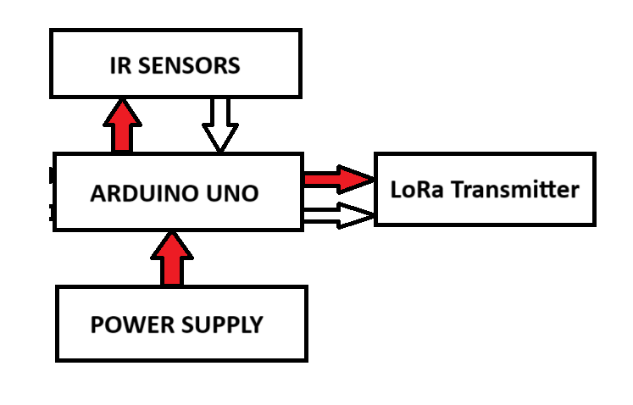
BLOCK Diagram of the sensor system
10
GSM Module
Velocity Detection Device

Slide 10
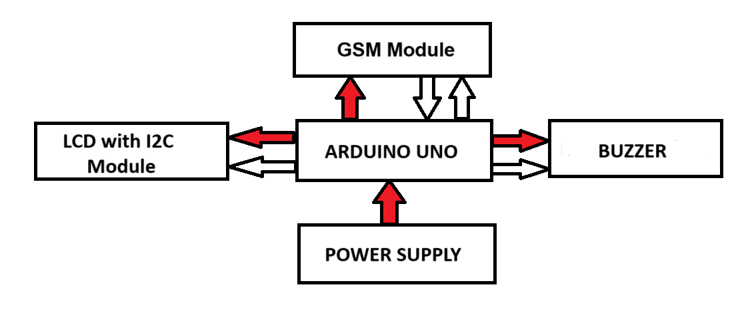
BLOCK Diagram of the device in train
11
Alert System

Slide 11
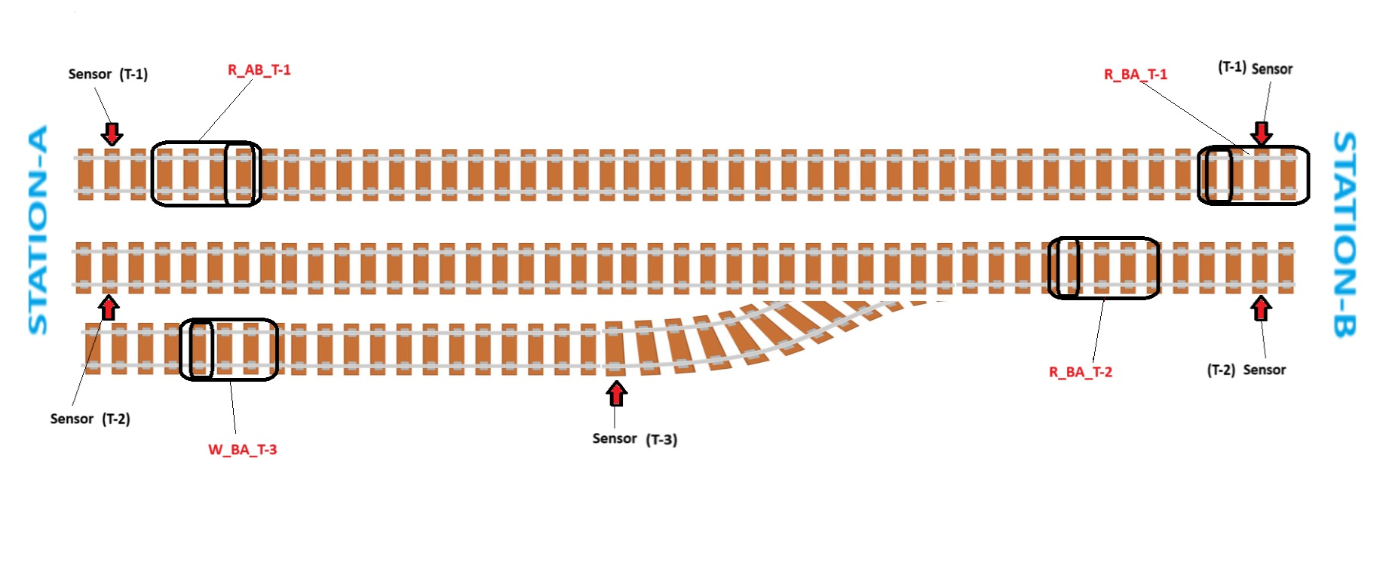
Working Concept
12

Slide 12
Working Concept
13
IR sensors in tracks detect the presence of a moving train.
Arduino Uno employs an algorithm for speed calculation.
Transmit track number and estimated time to reach next sensor via GSM module.
If train does not reach in time, system switches to waiting state.
Trains halt upon receiving conflicting track occupancy data to prevent collision.
LCD display with I2C module and buzzer on trains provides real-time alerts on possible collision.

Slide 13
challenges
14
Used HB100 Doppler radar sensor for speed and direction detection.
Using IR sensors for speed and direction detection.
Sunlight disturbance affects IR sensor performance.
Considering a transition to KY-032 IR sensor to overcome sunlight disturbance.

Slide 14
Future scope
15
Current project marks the beginning of advancements in railway safety.
Future plans involve a more sophisticated IoT architecture.
Inclusion of multiple devices, such as Raspberry Pi.
Aim is to build a robust system for detecting potential head-on collisions.

Slide 15
conclusion
16
Our project aims to develop an efficient system using IoT, Arduino, IR sensors and GSM module for real-time velocity detection and data transmission.
The core objective is to prevent train collisions by creating a cost-effective solution that ensures the continuous monitoring and transmission of velocity-related data.

Slide 16
references
17
[1] Javed, A. Building arduino projects for the internet of things. Experiments with Real-World Applications. United States of America: Apress Media, LLC 1, 15–34 (2016).
[2] Russell, B. and Van Duren, D. Practical Internet of Things security. Packt Publishing Ltd, (2016).
[3] Chantzis, F., Stais, I., Calderon, P., Deirmentzoglou, E., and Woods, B. Practical IoT hacking: the definitive guide to attacking the Internet of Things. No Starch Press, (2021).

Slide 17
thank you
18

